Slide 1

Single-Dimensional Arrays and C-Strings
TUIT
C++ Programming, Fall 2016
Lab #7
(I - part)

Slide 2
Read the lecture notes doing following tasks:
TUIT
Practice (I - part)
*Count occurrence of numbers;
Count the number of Vowels and Consonants;
**Print distinct numbers;
*Statistics: Compute deviation;
**Bubble sort;
*Game: locker puzzle
Strictly identical arrays;
Math: Combinations;
*Pattern recognition: consecutive four equal numbers;
**Sorted?;
**Partition of a list;
**Common elements;

Slide 3


TUIT
1. *Count occurrence of numbers
Write a program that reads at most 100 integers between 1 and 100 and counts the occurrence of each number. Assume the input ends with 0. Here is a sample run of the program:
Here is a sample runs:
Enter the integers between 1 and 100: 2 5 6 5 4 3 23 43 2 0 2 occurs 2 times 3 occurs 1 time 4 occurs 1 time 5 occurs 2 times 6 occurs 1 time 23 occurs 1 time 43 occurs 1 time

Slide 4
TUIT
2. Count the number of Vowels and Consonants
Write a program that reads an unspecified number of uppercase or lowercase alphabets, and determines how many of them are vowels and how many are consonants. Enter zero to signify the end of the input.
Here is the sample run:
Enter the characters: a B c D e f G 0 2 vowels 5 consonants

Slide 5
TUIT
3. **Print distinct numbers
Write a program that reads in 10 numbers and displays distinct numbers (i.e., if a number appears multiple times, it is displayed only once). (Hint: Read a number and store it to an array if it is new. If the number is already in the array, discard it. After the input, the array contains the distinct numbers.)
Here is the sample run:
Enter ten numbers: 1 2 3 2 1 6 3 4 5 2 The distinct numbers are: 1 2 3 6 4 5

Slide 6
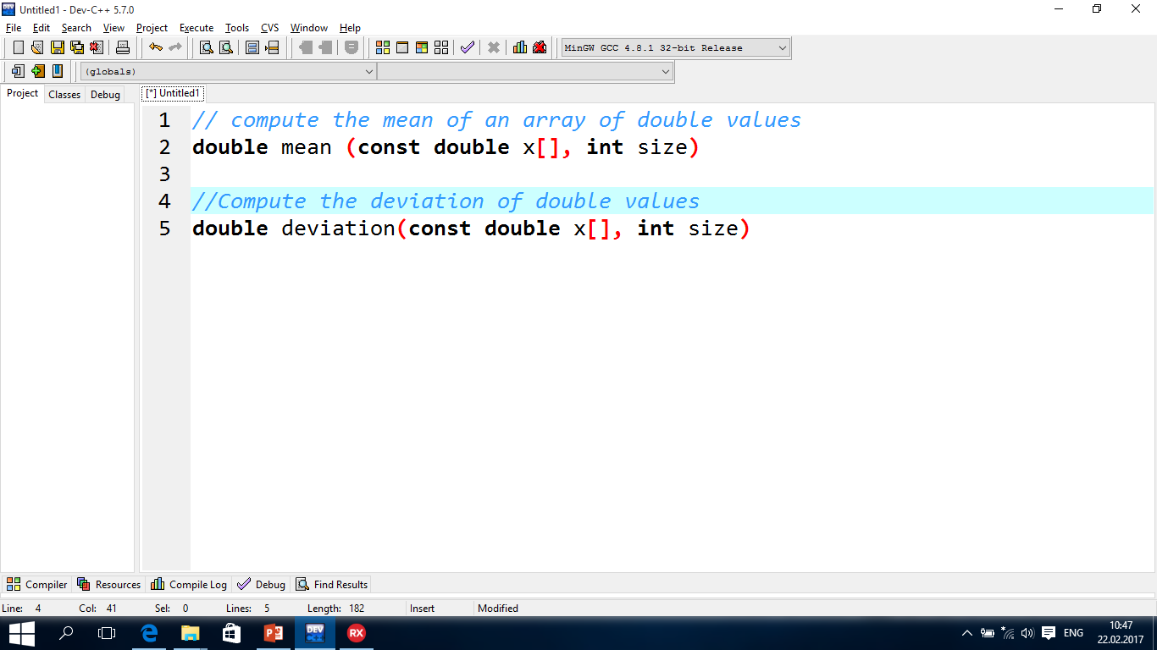
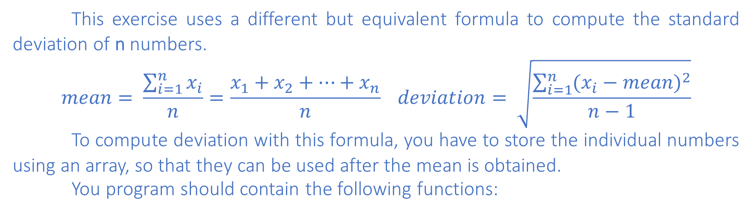
TUIT
4. *Statistics: Compute deviation
This exercise uses a different but equivalent formula to compute the standard deviation of n numbers.
$$mean= \frac{\sum_{i=1}^{n}{x_{i}}}{n}=\frac{x_{1}+x_{2}+…+x_{n}}{n} deviation= \sqrt{\frac{\sum_{i=1}^{n}{{(x_{i}−mean)}^{2}}}{n−1}}$$
To compute deviation with this formula, you have to store the individual numbers using an array, so that they can be used after the mean is obtained.
You program should contain the following functions:
Here is the sample run:
Enter ten numbers: 1.9 2.5 3.7 2 1 6 3 4 5 2 The mean is 3.11 The standard deviation is 1.55738

Slide 7
TUIT
5. **Bubble sort
Write a sort function that uses the bubble-sort algorithm. The algorithm makes several passes through the array. On each pass, successive neighboring pairs are compared. If a pair is in decreasing order, its values are swapped; otherwise, the values remain unchanged. The technique is called a bubble sort or sinking sort because the smaller values gradually “bubble” their way to the top and the larger values sink to the bottom.

Slide 8
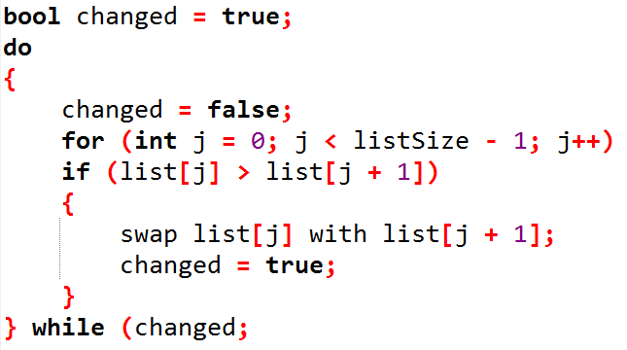
TUIT
5. **Bubble sort
The algorithm can be described as follows:
Clearly, the list is in increasing order when the loop terminates. It is easy to show that the do loop executes at most listSize – 1 times.
Here is the sample run:
Enter a list size: 10 Enter a list: 10 6 2 3 1 5 4 0 7 8 Sort list: 0 1 2 3 4 5 6 7 8 10

Slide 9
TUIT
6. *Game: locker puzzle
A school has 100 lockers and 100 students. All lockers are closed on the first day of school. As the students enter, the first student, denoted S1, opens every locker. Then the second student, S2, begins with the second locker, denoted L2, and closes every other locker. Student S3 begins with the third locker and changes every third locker (closes it if it was open, and opens it if it was closed). Student S4 begins with locker L4 and changes every fourth locker. Student S5 starts with L5 and changes every fifth locker, and so on, until student S100 changes L100.

Slide 10
TUIT
6. *Game: locker puzzle
After all the students have passed through the building and changed the lockers, which lockers are open? Write a program to find your answer and display all open locker numbers separated by exactly one space.
(Hint: Use an array of 100 bool elements, each of which indicates whether a locker is open (true) or closed (false). Initially, all lockers are closed). Here is the sample run:
1- locker: Open 4- locker: Open 9- locker: Open 16- locker: Open 25- locker: Open 36- locker: Open 49- locker: Open 64- locker: Open 81- locker: Open 100- locker: Open

Slide 11
TUIT
7. Strictly identical arrays
Two arrays list1 and list2 are strictly identical if they have the same length and list1[i] is equal to list2[i] for each i. Write a function that returns true if list1 and list2 are strictly identical using the following header:
bool strictlyEqual(const int list1[], const int list2[])
Write a test program that prompts the user to enter two lists of integers and displays whether the two are strictly identical. The sample runs follow. Note that the first number in the input indicates the number of elements in the list. This number is not part of the list. Assume the list size is maximum 20.
Enter list1: 5 2 5 6 1 6 Enter list2: 5 2 5 6 1 6 Two lists are strictly identical
Enter list1: 5 2 5 6 6 1 Enter list2: 5 2 5 6 1 6 Two lists are not strictly identical

Slide 12
TUIT
8. Math: Combinations
Write a program that prompts the user to enter an integer and displays all combinations to get that integer as a sum of two dice.
Here is a sample run:
Enter an integer: 10 0 + 10, 1 + 9, 2 + 8, 3 + 7, 4 + 6, 5 + 5, 6 + 4, 7 + 3, 8 + 2, 9 + 1, 10 + 0

Slide 13
TUIT
9. *Pattern recognition: consecutive four equal numbers
Write the following function that tests whether the array has four consecutive numbers with the same value.
bool isConsecutiveFour(const int values[], int size)
Write a test program that prompts the user to enter a series of integers and displays if the series contains four consecutive numbers with the same value. Your program should first prompt the user to enter the input size – i.e., the number of values in the series. Assume the maximum number of values is 80. Here are sample runs:
Enter the number of values: 8 Enter the values: 3 4 5 5 5 5 4 5 The list has consecutive fours
Enter the number of values: 8 Enter the values: 3 4 5 5 6 5 5 4 5 The list has no consecutive fours

Slide 14
TUIT
10. **Sorted?
Write the following function that returns true if the list is already sorted in increasing order:
bool isSorted(const int list[], int size)
Write a test program that prompts the user to enter a list and displays whether the list is sorted or not. Note that the first number in the input indicates the number of the elements in the list. This number is not part of the list. Assume the maximum list size is 80. Here is a sample run:
Enter list: 8 10 1 5 16 61 9 11 1 The list is not sorted
Enter list: 10 1 1 3 4 4 5 7 9 11 21 The list is already sorted

Slide 15
TUIT
11. **Partition of a list
Write the following function that partitions the list using the first element, called a pivot:
int partition(int list[], int size)
After the partition, the elements in the list are rearranged so that all the elements before the pivot are less than or equal to the pivot and the element after the pivot are greater than the pivot. The function also returns the index where the pivot is located in the new list. For example, suppose the list is {5, 2, 9, 3, 6, 8}. After the partition, the list becomes {3, 2, 5, 9, 6, 8} . Implement the function in a way that takes size number of comparisons.

Slide 16
TUIT
11. **Partition of a list
Write a test program that prompts the user to enter a list and displays the list after the partition. Note that the first number in the input indicates the number of elements in the list. This number is not part of the list. Assume the maximum list size is 80.
Enter list: 8 10 1 5 16 61 9 11 1 After the partition , the list is 9 1 5 1 01 61 11 16

Slide 17
TUIT
12. **Common elements
Write a program that prompts the user to enter two arrays of 10 integers and displays the common elements that appear in both arrays. Here is a sample run:
Enter list1: 8 5 10 1 6 16 61 9 11 2 Enter list2: 4 2 3 10 3 34 35 67 3 1 The common elements are 10 1 2

